Slide 1
ONDAWARE
Presented to: Mr.Ramon
Instructor: Regine Gilbert
Course: Human Computer Factors and Usability Metrics
Presented by:
Raj patel
Sindhu Venugopal
Harish maganti
Saumil patel

Slide 2
PROJECT DESCRIPTION:
Textile and clothing recycling is a potentially beneficial activity from environmental, social and economical points of view, as opposed to landfilling or being used for energy. As cities increasingly are diverting other high volume waste streams such as organic, the recycling of old clothes has been called the next frontier for cities looking to reduce solid waste. Only about 0.1% of recycled fiber collected by charities and take back programs is recycled into new textile fiber. More than $500 billion of value is lost every year due to only clothing underutilization and the lack of recycling. Ondaware is a zero waste, closed loop Product Company. Ondaware is trying to find new ways to make this recycling loop intact.
Goals:- To find a better solution for textile recycling process. Which means that all the materials used to make clothes eventually come back to its parent company for future recycling.

Slide 3
PROBLEM STATEMENT:
Ondaware needs ways to manage reusable waste to avoid landfill or incinerate wastes, also consumers are not aware of the concept of circular economy which is leading to numerous negative environmental and social impacts.
HYPOTHESIS:
We believe that by introducing / encouraging new ways of waste management and re-use of recyclable products, we will achieve the concept of circular economy and be more environmentally responsible.

Slide 4
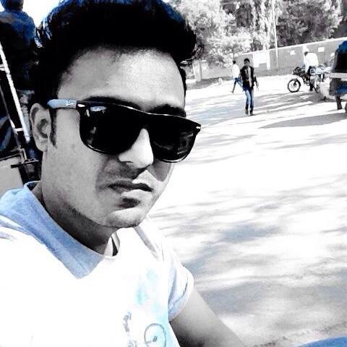
PERSONA:
Rohan is a Student at Pace University he is 28 years old, and he volunteer for Save Earth Organization he has lots of care about environment and always try to save environment in each possible way.
Painpoints | Goals | Motivations
There are very few outlets where he can give clothes for recycling and altering. | He wants textile industries to recycle the clothes. | By altering the expensive branded clothes and giving at a lower price to the needy people makes him feel happy
He does not like his expensive and branded clothes to be recycled. | He wants his clothes to be used by the people again. | There are still people who care about the environment and what Ondaware does motivates him to do something from his side.
He don’t know what to do with his unwanted clothes lying around in his wardrobe | He wants more outlets for the collection of the used clothes .

Slide 5
RESEARCH QUESTIONS:
1) What is your profession?
Survey was conducted online and in person (user-interview) with 30 participants.

Slide 6

2)What do you think about environmental pollution?
By analysis of all the responses, we came to an understanding that all the people are aware about this issue but they don’t have proper practical solution which they can contribute towards making a better tomorrow.

Slide 7

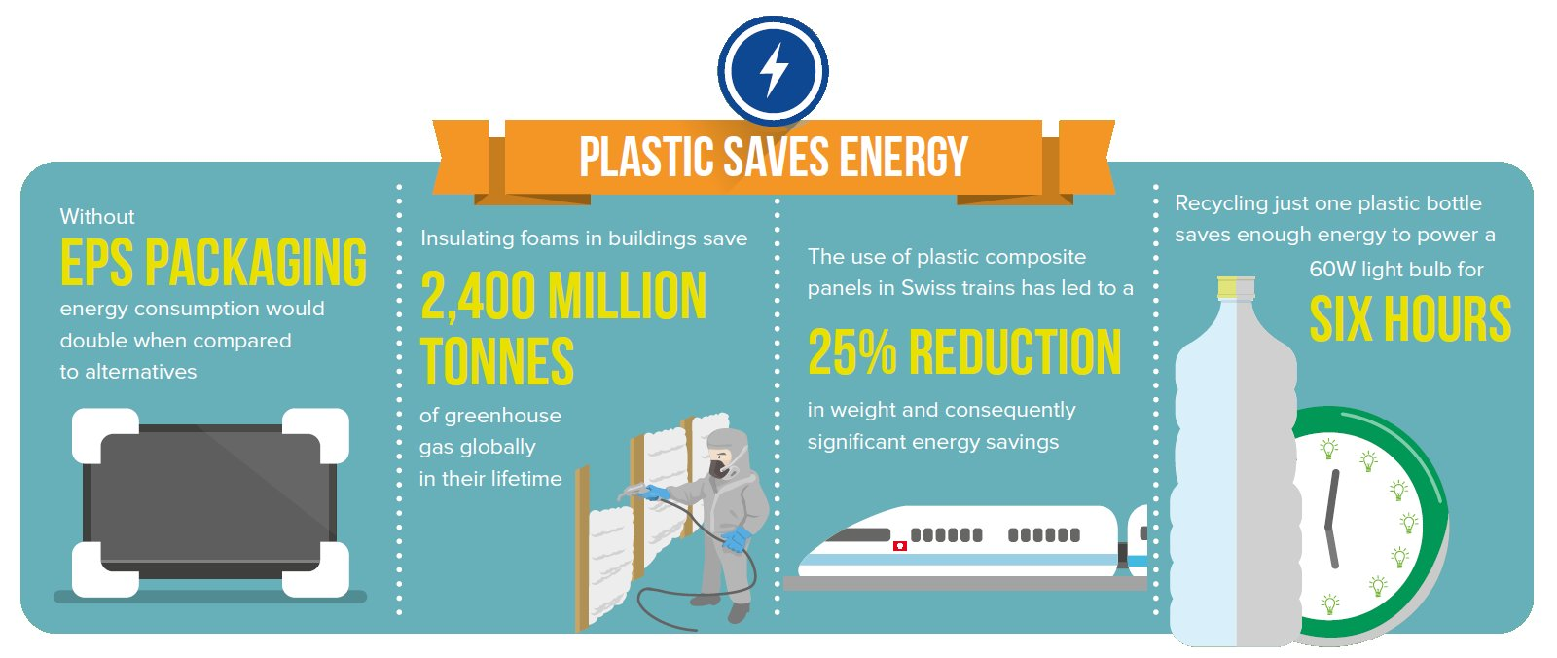

3)What steps did you take to protect mother earth in you day-to-day life?
Save water and food was the most responded answer
Avoiding plastic was second most

Slide 8
4) How often do you buy clothes and how much do you spend on them?
On an average,
10 times/Yr
&
$700/Yr

Slide 9
5) What do you do after you are done using them?
Have you ever heard of clothes recycling?

Slide 10
6) Will you donate your clothes for recycling after you are done using them for free?

Slide 11
INSIGHTS ON USER INTERVIEWS (30 PPL):
&
$700/Yr
On an average,
10 times/Yr
There is definitely a great need to think of stratergies to manage plastic waste (recyclable waste)
They would be more comfortable if they have collection centers at a walkable distance or if some reliable authority can collect it from them personally
Very much opened if they would get rewards/ incentives
They are ready to recycle their clothes for good causes.
Expect government or environmentalists to create awareness through social media , at work places , shopping malls etc.,
They are open to collecting recyclable waste collected at home or work place for a good cause (like what Ondaware is doing)
Not many are aware of even easier steps they can take from their side

Slide 12

STORY BOARDING

Slide 13

IDEAS: (Feature Prioritization)
By understanding user’s responses we came up with the following drafted ideas which could possibly be solution to our problem.
Close-by collection centers
Incentives or rewards for collecting re-usable products
Collection centers at places where camps/campaigns are conducted
Deals with laundromats, clothing stores to collect the re-usable products
Create an Application or website to create awareness on the concept of circular economy , notify the users regarding the collection centers, rewards , camps etc..
Fading tag which can be use to track how many time you washed the cloth to give users feedback about the cloth.
OLD
NEW

Slide 14
USER FLOW:
BUY PRODUCTS
OPEN APP & SIGN IN/UP
SEARCH FOR NEARBY CENTERS
TO RETURN WHEN ITS OLD
DROP OFF YOUR USED PRODUCTS AND SEE UPDATES ON APPS
TRACKING,
GET REWARDS & NOTIFICATIONS ABOUT EVENTS

Slide 15
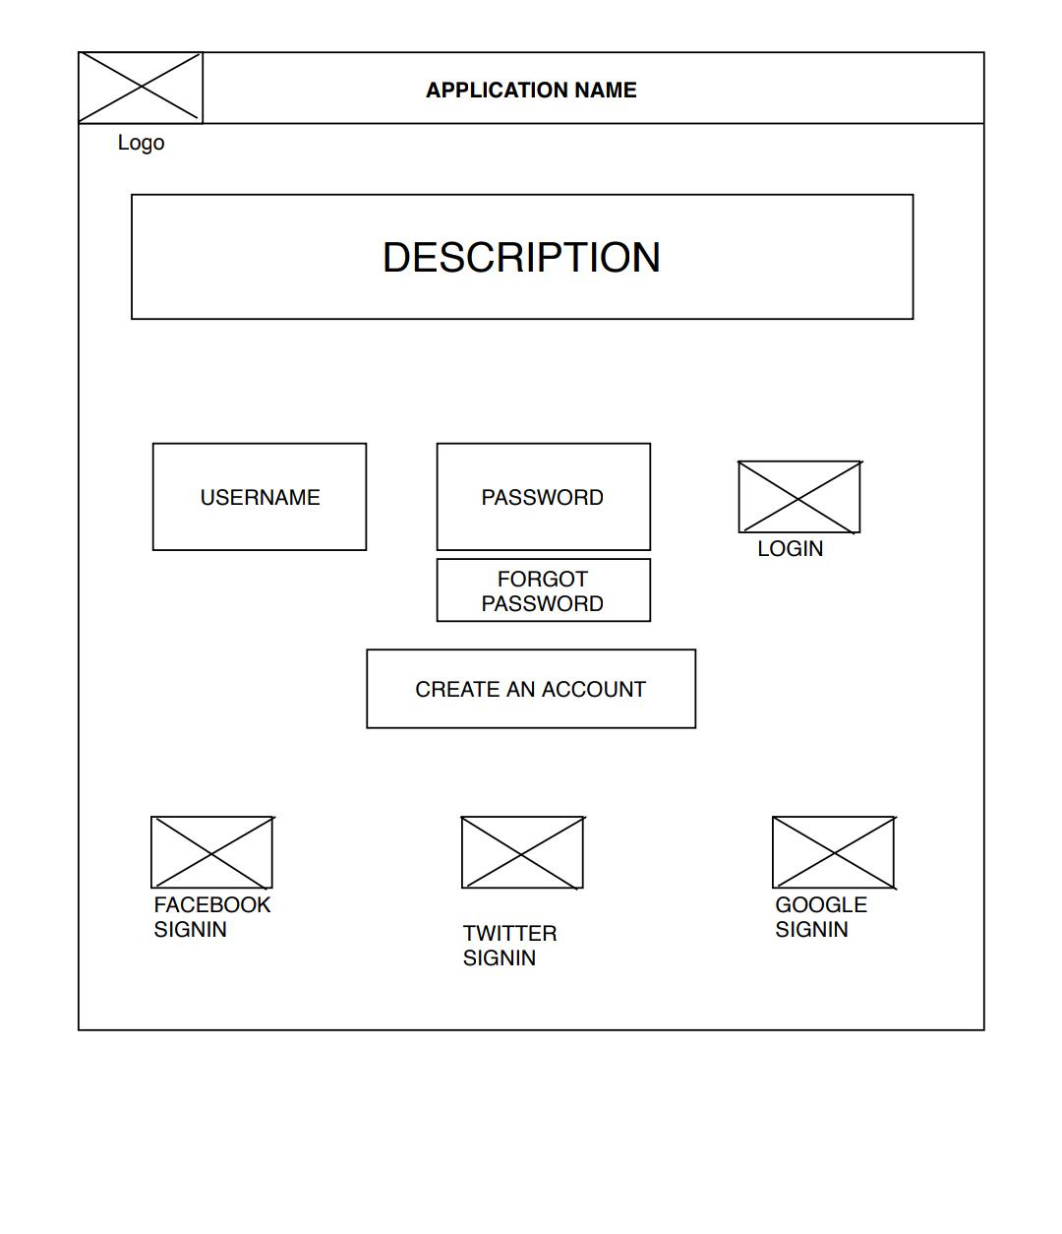
WIREFRAMES:
LOGIN PAGE

Slide 16
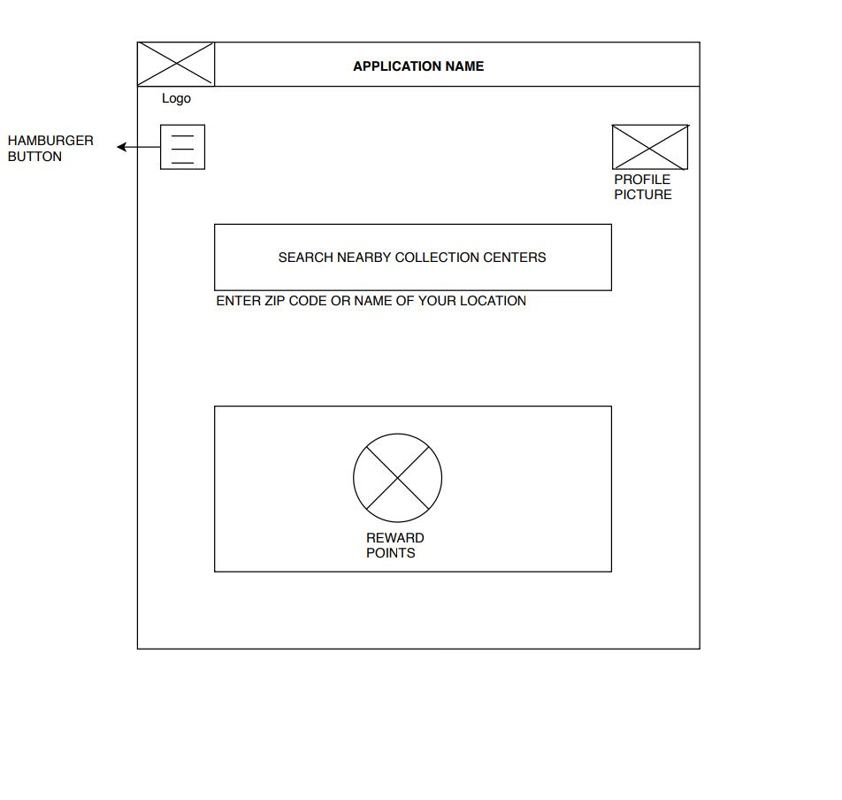
LANDING PAGE/ HOME PAGE

Slide 17
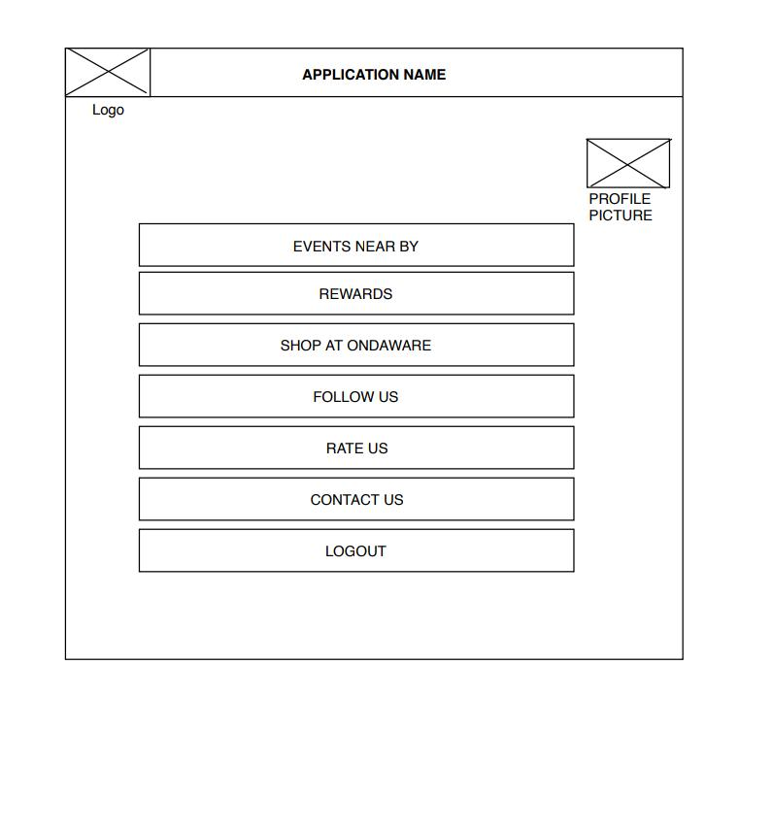
HAMBURGER PAGE

Slide 18
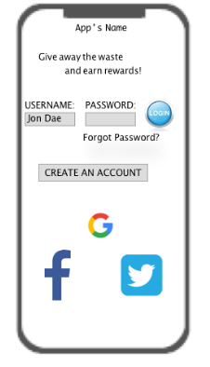
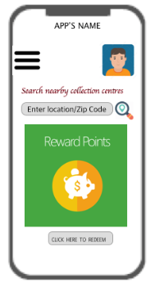
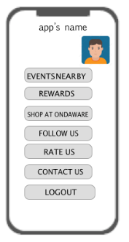
INTERFACES:
LOGIN PAGE
LANDING /HOME PAGE
HAMBURGER PAGE

Slide 19
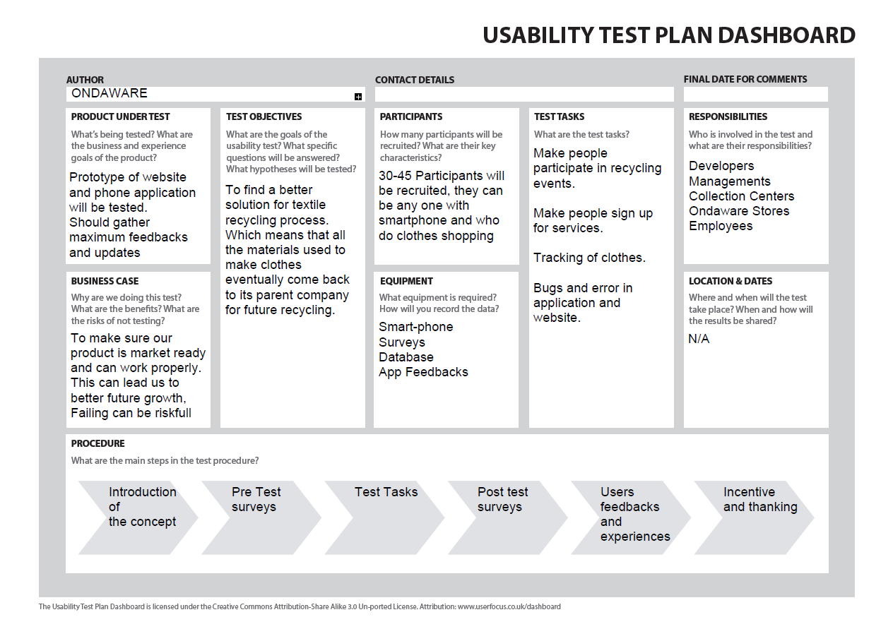
USABILITY TESTING

Slide 20
THANK YOU!

